Slide 1
Automatic Loop Parallelization
PAAV 2015 Final Project
Submitted by: Yogev Vaknin, Itay Polack
Lecturer: Noam Rinetzky

Slide 2
Agenda
Motivation
Introduction: loop parallelization
Short introduction to dependency analysis
Short introduction to OpenMP
Project implementation
Evaluation
Discussion

Slide 3
Motivation
We would like to improve software performance
We want a significant improvement
We want minimal development effort
The program output must not change
The program performance must not degrade

Slide 4
Idea
Focus on specific program aspects that are -
Common
Resource demanding (usually)
Easy to improve (some times)
Loops!
Common structure
Many iterations running the same code
Long loops have significant performance cost

Slide 5
How?
Many existing optimizations
Extract loop invariant code outside the loop
Loop unrolling
Perform the loop concurrently
… and many more!
Perform the loop concurrently
Many identical threads
Each one is running a partition of the loop iterations

Slide 6
Loop Parallelization
Before
After
Run the loop for N iterations
Create X threads, each one is running N / X iterations
Wait for all threads to finish

Slide 7
Example - Code
Before
After
for (int i = 0; i < 100000; ++i) { A[i] = B[i] / 2; }
void loop_thread(int start, int end) { for (int i = start; i < end; ++i) { A[i] = B[i] / 2; } }
pthread_create( &thread1, NULL, loop_thread, (void*) { .start = 0, .end = 10000 }); pthread_create( &thread2, NULL, loop_thread, (void*) { .start = 10001, .end = 20000 }); // ... Open as many threads as required ... pthread_join( thread1, NULL); pthread_join( thread2, NULL);

Slide 8
The Dependency Challenge
Many loops have cross-iteration dependencies
Example:
int i, fib[1000]; fib[0] = 1, fib[1] = 1; for (i = 2; i < 1000; ++i) { fib[i] = fib[i - 1] + fib[i - 2]; }
Each iteration depends on the previous two iterations
What happens if we try to parallelize this loop?

Slide 9
What is a Dependency?
Two different instructions accessing the same memory means there is a dependence between them
Given two program instructions, T and S, that access the same memory location:
If S is a write and T is a read, this is a flow dependence
If S is a read and T is a write, this is an anti-dependence
If S is a write and T is a write, this is an output dependence
If S is a read and T is a read, this is an input dependence

Slide 10
Dealing with Cross-Iteration Deps
Replace dependent code with independent code
For example: implicit formula for Fibonacci sequence
Efficient, but hard to implement and fits very few cases
Attempt to resolve cross dependencies
For example: if a single iteration causes dependence, run it beforehand and parallelize the rest
Efficient in many cases, but hard to implement and sometimes risky
Ignore dependent loops
Simple!

Slide 11
Dependency Testing: Approach
Conservative
"No dependence" result means: we proved there are no cross iteration dependencies
"Dependence found" result means: there might be a dependency
Practical
Try to cover most cases by focusing on common and easy-to-solve scenarios
Assume dependency in complex cases
Result is correct, but may be less than optimal

Slide 12
Dependency Testing: Method
Focus on array reference operations
Scalar variables can be treated as a single-element arrays
Pointer access can sometimes be handled by alias analysis

Slide 13
Basic Definitions
Index is a loop variable
For example:
for (j = 0; j < 100; ++j) { … }
j is the index
Subscript is a pair of expressions that appear in certain coordinate in a pair of array references
For example:
A[i, j, k] = A[i + 1, j, k - 1] + 100;
The subscripts are <i, i + 1>, <j, j>, <k, k - 1>

Slide 14
Basic Definitions
The relation between the elements in each subscript pair can be described by distance and direction
For example:
For the subscript <j, j + 1>, the distance is 1 and the direction is <
When there are multiple subscripts, we will use a direction/distance vector, where each element matches the corresponding subscript
Merging direction vectors (in our domain): Cartesian product
There might be dependencies in multiple directions at the same time

Slide 15
Dependency Tests
Given a subscript pair -
Is there a dependency?
Can we calculate the dependency direction?
Can we calculate the dependency distance?
The general case is undecidable
A complex example:
scanf("%d", &var); for (i = 0; i < 100; ++i) { for (j = 0; j < 100; ++j) { A[var + pow((i + j), 5)] = A[pow(i, j) + i * i - 5000]; } }

Slide 16
Dependency Tests
Most programs use simple subscripts
Assume integers only
Assume linear subscript expressions only
For the rest, assume dependency
Problem can be reduced to solve a simple equation: are there index variables for which the subscript elements get the same value?
For example:
for (int i = 0; i < 100; ++i) { A[i] = A[2 * i + 1]; }
Can be reduced to the following Diophantine equation: i= i' * 2 + 1

Slide 17
Dependency Tests: GCD Test
Solving a system of Diophantine equations is NP-complete
But, we can use a simple algorithm to know if such solution exists: GCD test
Given an equation of the form a_1 * x_1 + a_2 * x_2 + … + a_n * x_n = c, for x_1 … x_n loop indices, a_1 … a_n coefficients, and c constant, solution exists if and only if the greatest common divisor (GCD) of all coefficients divides c
Limited
Ignores loop bounds, leading to false positives
The GCD is 1 in many case, leading to false positives
Binary answer, no direction or distance

Slide 18
GCD Test: Examples
// gcd(5, 10) does not divide 139 - no dependency
for (i = 1; i < 100; ++i) { for (j = 1; j < 100; ++j) { A[5 * i] = A[-10 * j + 139]; } }
// gcd(1, -1) divides 100, but there is no dependency due to loop bounds
for (i = 0; i < 10; ++i) { A[i] = x; x = A[i - 100]; }

Slide 19
Dependency Tests: More Tests
GCD covers a lot of cases, but is quite limited
Banerjee test is an variation on the GCD test that can imply bounds
When certain constraints are met, specific tests can be used, depending on the subscript complexity
ZIV subscript is a subscript with no indices
Both expressions are loop invariants
SIV subscript contains a single index
MIV subscript contains multiple indices

Slide 20
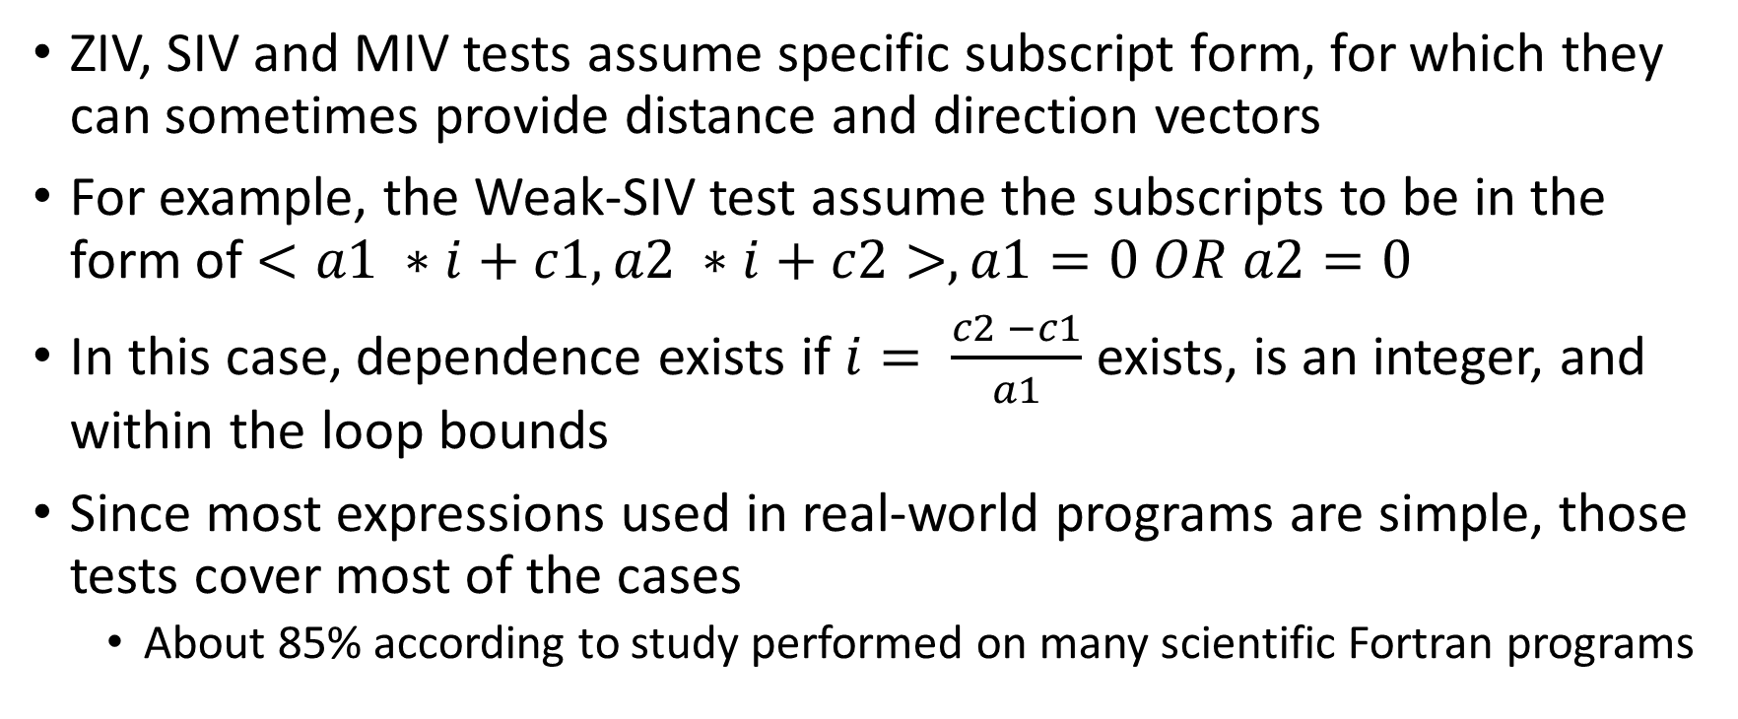
Dependency Tests: Specific Tests
ZIV, SIV and MIV tests assume specific subscript form, for which they can sometimes provide distance and direction vectors
For example, the Weak-SIV test assume the subscripts to be in the form of $<a1 ∗i+c1, a2 ∗i+c2>, a1=0 OR a2=0$
In this case, dependence exists if $i= \frac{c2 −c1}{a1}$ exists, is an integer, and within the loop bounds
Since most expressions used in real-world programs are simple, those tests cover most of the cases
About 85% according to study performed on many scientific Fortran programs

Slide 21
Separable and Coupled Subscripts
A subscript is separable if its indices do not occur in other subscripts
If two different subscripts contain the same index they are coupled
Dealing with coupled subscripts requires additional care, as naïve approach could cause imprecision
For example, in this code we have multiple subscripts sharing the same index variable:
for (int i = 1; i < 100; ++i) { A[i + 1][i] = B[i] + C; D[i] = A[i][i] * E; }
Separate calculation might lose crucial data and lead to incorrect output

Slide 22
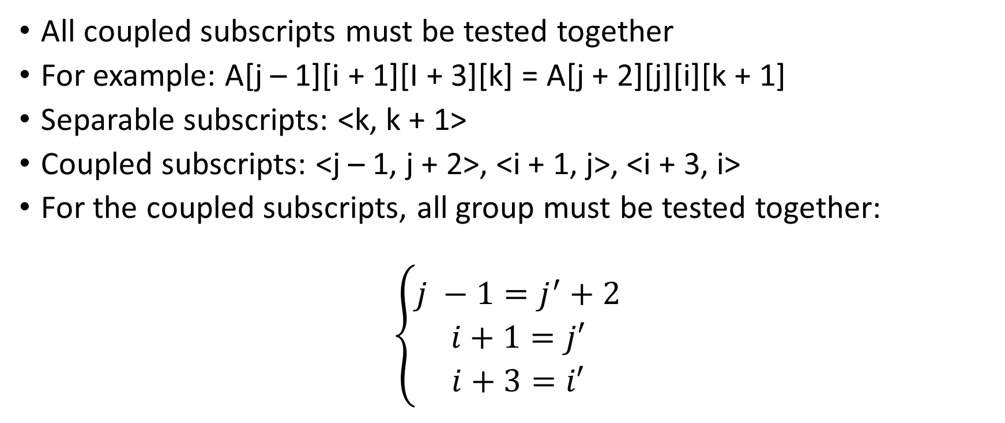
Separable and Coupled Subscripts
All coupled subscripts must be tested together
For example: A[j – 1][i + 1][I + 3][k] = A[j + 2][j][i][k + 1]
Separable subscripts: <k, k + 1>
Coupled subscripts: <j – 1, j + 2>, <i + 1, j>, <i + 3, i>
For the coupled subscripts, all group must be tested together:
$$\left\{\begin{aligned}j −1=j^{′}+2 \\ i+1=j′ \\ i+3=i′\end{aligned}\right.$$

Slide 23
Dependence Analysis: Suggested Algorithm
Input: a pair of array references and loop bounds
Partition subscripts into separable and coupled groups
Classify each subscript as ZIV, SIV or MIV
For each separable subscript: apply dependency test
If independence established, return “no dependence” and halt
For each coupled group: apply dependency test
If independence established, return “no dependence” and halt
Merge all direction vectors computed in previous steps into a single step of direction vectors

Slide 24
OpenMP: Introduction
Framework for shared-memory and multithread programming
Simple and flexible interface for developing parallel applications
Supports C, C++ and Fortran
Supports many architecture and operating systems
Even supercomputers!
Transforms sequential code to parallel code using simple compiler directive and commands

Slide 25
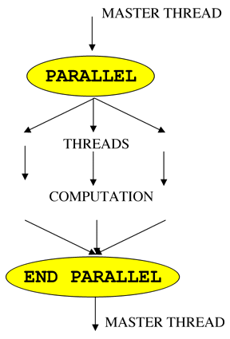
OpenMP: Model
Fork-join model
Master thread, parallel sections
Master thread spawns threads when reaching parallel section
Parallel sections are performed simultaneously
Master thread wait for all threads to finish before proceeding
Performance cost
Fork and join operations
Possibly less efficient usage of cache

Slide 26
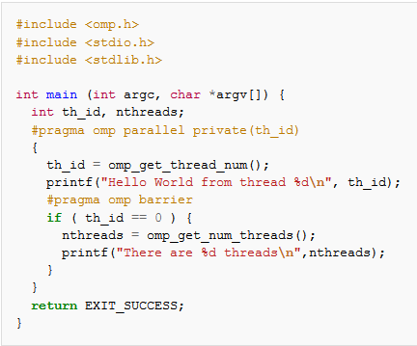
OpenMP: Hello World Example

Slide 27
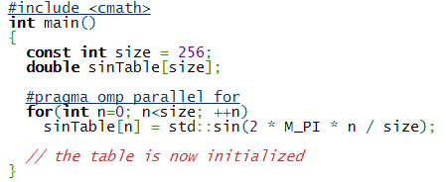
OpenMP: Loop Example

Slide 28
Putting It All Together
Our tool is putting everything together, aiming for automatic process of parallelizing loops
Input: a list of target source files, input for profiling the resulting program
Process:
Analyze the source code for loops that can be transformed to work in parallel
Use OpenMP for transforming eligible loops
Build and profile the transformed programs using the provided input
Select loops to parallel only if the performance improved

Slide 29
Implementation: Technical Details
The tool was implemented in Python
Dependency analysis was written as LLVM pass, implemented in C++
Requirements:
Linux-based operating system
LLVM 3.6
OpenMP
Python
C compiler

Slide 30
Implementation: Dependency Analysis
Written in C++, as LLVM pass
Analysis only
Uses LLVM’s DependenceAnalysis pass for finding dependencies
For each loop, apply dependence testing for each pair of store/load instructions
Output loops that are eligible to run in parallel
Meaning: independence was proven
Very cautious
Skip nested loops
Only suggest loops it is completely sure about

Slide 31
Implementation: Transforming to Parallel
Written in Python
Transformation is done in source level, by injecting special code
Apply transformation for each loop suggested by the LLVM pass
Use OpenMP’s special pragma for the parallelization: “pragma omp parallel for”

Slide 32
Implementation: Profiling
Written in Python
Inject timing code before and after each loop that is candidate for parallelization
Run each program twice: with and without parallelization
Rely on user’s input
Collect timing information and evaluate effect of parallelization
Effect is evaluated per loop, not per program

Slide 33
Evaluation
Sample programs we created as part of the development process
Starbench: parallel benchmark suite
A collection of numerical programs, covering multiple subjects
AI algorithms
Image processing
Compression
Etc.

Slide 34
Evaluation Results
No improvement over the baseline
No significant loops, in terms of performance, were parallelized
The conservative nature of our dependence analysis made us ignore most loops, and all significant ones
Due to OpenMP’s overhead, there is no gain when trying to parallelize small or insignificant loops

Slide 35
Discussion
In its current form, the automatic process provides little to no benefit for real-world scenarios
Complex code inside the loop will almost always lead to dependency assumption
Idea: Improve the dependency testing – can we get less false positives?
Idea: Remove dependencies by changing the code
Very simple in some cases, feasible in many cases
By applying such changes, we might reduce dependencies
Great learning experience
Challenging project
We learned a lot about LLVM, OpenMP, and the subject of dependence analysis

